Slide 1
HantsLUG 2013:
Improving Home Broadband
James Bensley jwbensley@gmail.com
hampshire@mailman.lug.org.uk

Slide 2
Broadband Recap

Slide 3
Broadband Recap
A quick recap:
What is Broadband?
Who provides it?
How is it delivered to us?
Where does it come from?
Why do we have it?

Slide 4
What Is Broadband?
Narrow Band: 1991, March: Piped first UK dial-up Internet provider (ITU-T V.90/V.92). Horrible dying cat noises, picking up the phone could disconnect the connection (pre MoH), billed like a telephone call (i.e. 2p per minute), roughly 5-7Kbps max download speeds. 300Hz to 3.4kHz.
Broadband: 2000-ish: BTW launch first ADSL offering (ADSL1/ADSL Max). Initial standardisations at 26kHz to 1,100kHz (ANSI T1.413 Issue 2 and ITU G.992.1 (G.DMT) & G.992.2 (G.Lite). Achievable download speeds of up to 700-800Kbps, later developed into ADSL2/2+ ITU G.992.3 onwards, Upto 24Mbps download using frequencies up to 2.2MHz

Slide 5
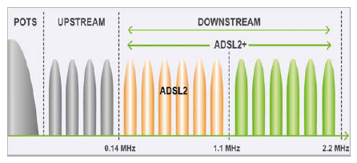
Broadband Frequencies
Stolen from: http://en.wikipedia.org/wiki/G.992.3

Slide 6
Home Broadband
Who provides it?
BT Direct / Kingston (KCOM) / VirginMedia (NTL) Cable
BT Wholesale: AAISP, Clara, Enta, Web Tapestry
LLU Provider: O2/BE, Sky, TalkTalk, Virgin, Zen
How is it delivered to us?
Traditional copper technologies: ADSL, SDSL, VDSL
Coax/Cable: DOCSIS
TDM copper: ISDN2/30, PRI/BRI/E1
Where does it come from?
Telephony line
WiMAX/Metro Wifi
2G/3G/GPRS/HSDPA
4G/LTE

Slide 7
Why Broadband?
Home Internet usage is on the up:
Triple play services: 1 Provider = Voice, Broadband, TV
Netflix is now >30% of all North American traffic, single largest Internet traffic source, slowly growing in the UK, Netflix UK < BBC iPlayer < 10% UK traffic
YouTube >20% all mobile Internet traffic in Europe. 1B page views per day (2009), 72 hours of video uploaded every minute (2012)
Increase in HD audio/video stream: BBC iPlayer, 4oD, Netflix, Lovefilm. Olympics 2012 Akamai average stream rate of 1,200Kbps. 100m mens final peak traffic for the entire event at 873Gbps. Akamai served 9,300 years of video in two weeks.
Increase in VoIP: SIP accounts for ~5% of all UK calls between Q3-Q4 2012
LINX >1.6Tbps peak traffic rate, AMS-IX & DEC-IX >2Tbps

Slide 8
Measuring Improvement

Slide 9
Measuring Improvement
Baseline: If you don't take one, you can't truly benefit www.speedtest.net speedtest.vostron.net traceroute/mtr ping (icmp/udp)
Look at your stats: http://www.kitz.co.uk/adsl/linestats_explanation.htmsync rate/line rate attenuation signal-to-noise ration/SNR/noise margin receive/input power transmit/output power
Monitoring: SNMP stats using Cacti or similar snmwalk/snmget if you have to HTTP interface

Slide 10
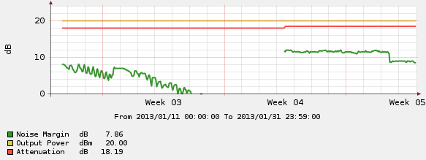
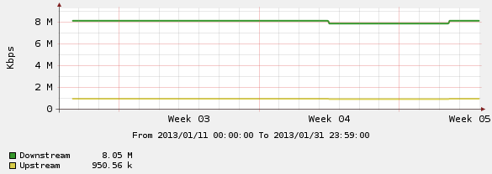
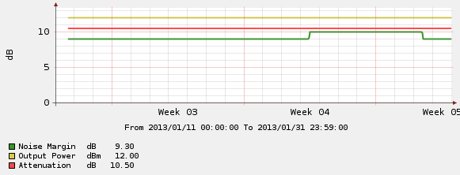
DSL Line Stats

Slide 11
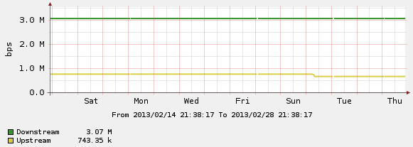
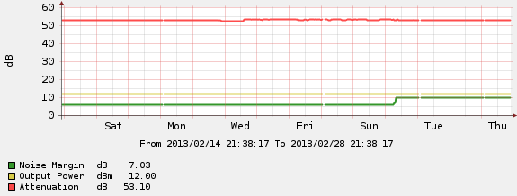
DSL Line Stats Cont.

Slide 12
External Wiring

Slide 13
External Wiring
Check for damaged street furniture
Check at the premises partition between internal and external divide
Storms and bad weather can and will affect your service due to the obvious, interference, additionally power surges can damage your modem/router and demolish telegraph poles!
BT MBORC - Good ISP will relay this

Slide 14
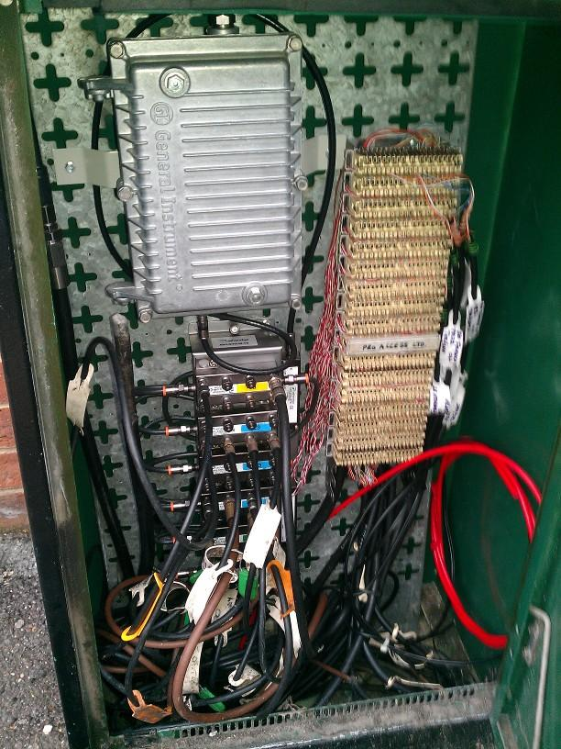
Damaged Street Furniture
Open VM Cab

Slide 15
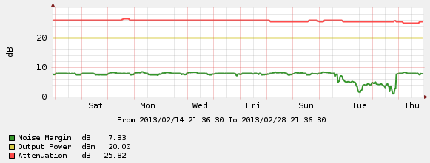
Storms And Bad Weather
Storm affected ADSL line

Slide 16
Last Mile Wiring

Slide 17
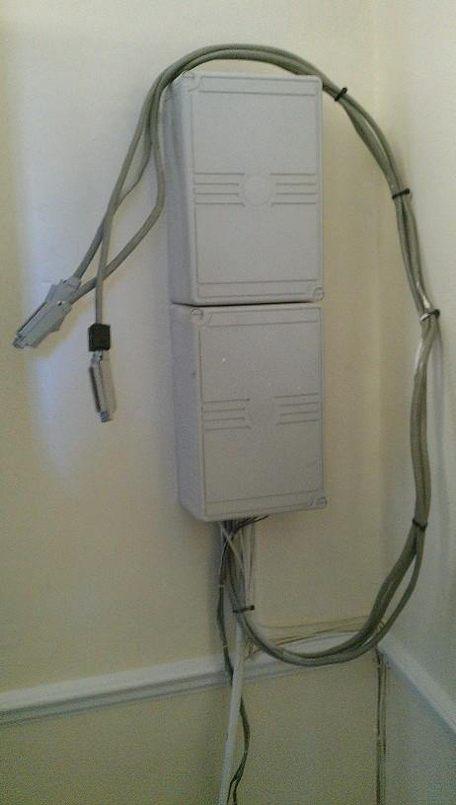
Last Mile Improvements
All wiring, sockets, DPs, krone bays etc belong to BT. BT must look after them in accordance with their SLAs, NOT YOU!
Check internal wiring
Check bell wiring
Check external wiring

Slide 18
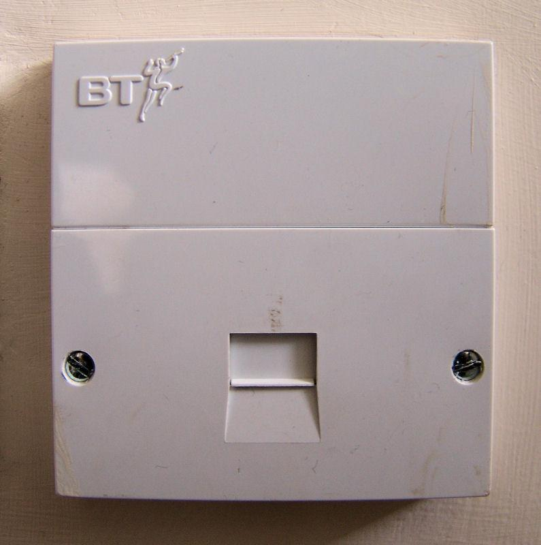
Internal Wiring
The "master socket" is the first socket the incoming BT line connects to upon entering the premises or breaking out from a DP
Always use the master socket
Disconnect secondary sockets
Disconnect fax machines
Avoid RedCare or Alarm Services

Slide 19
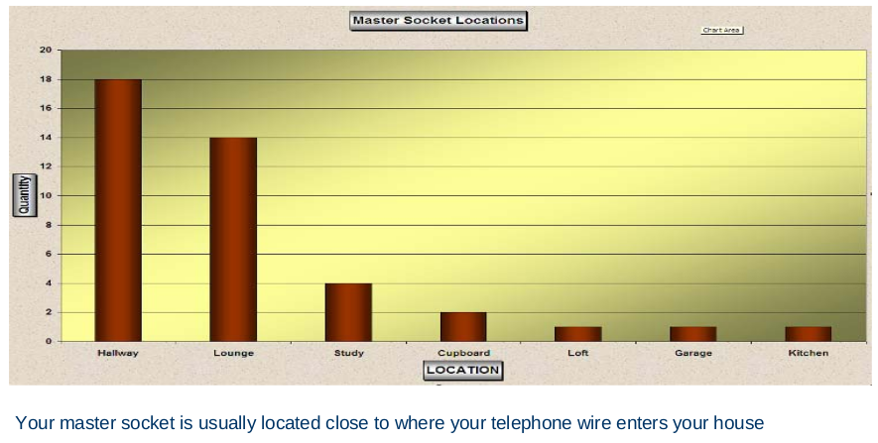
Master Socket Location

Slide 20
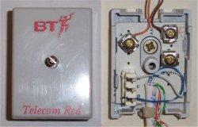
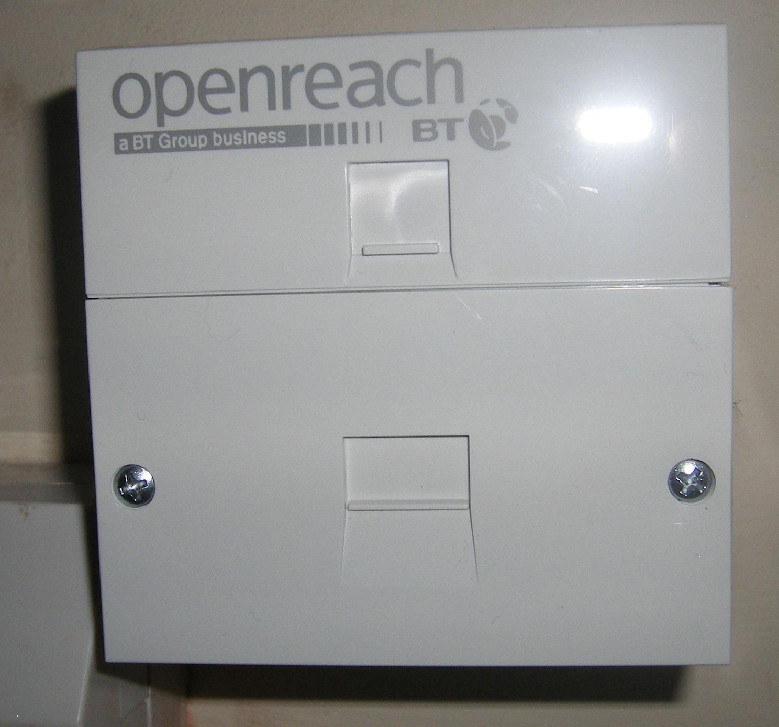
BT Sockets
Typical BT/RedCare Connection
Typical BT Openreach Socket

Slide 21
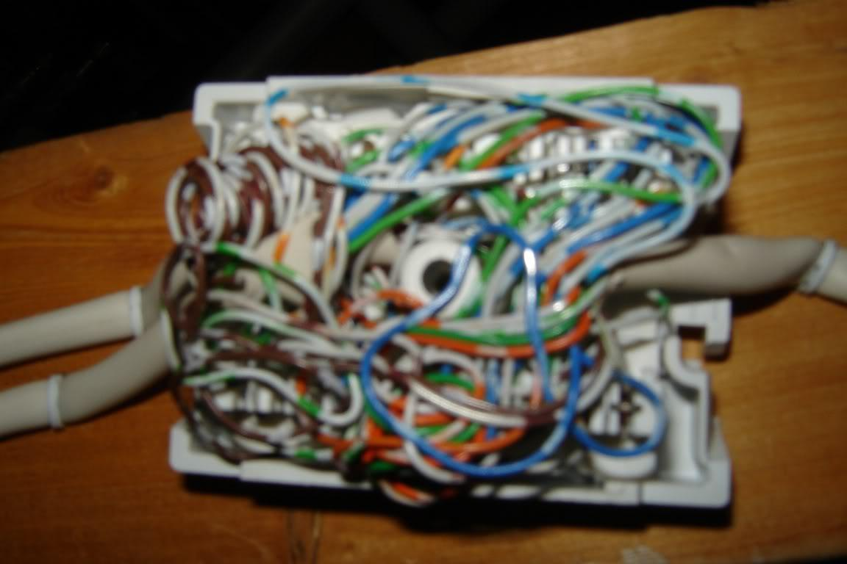
Worst Case Scenario
Typical extension/junction box

Slide 22
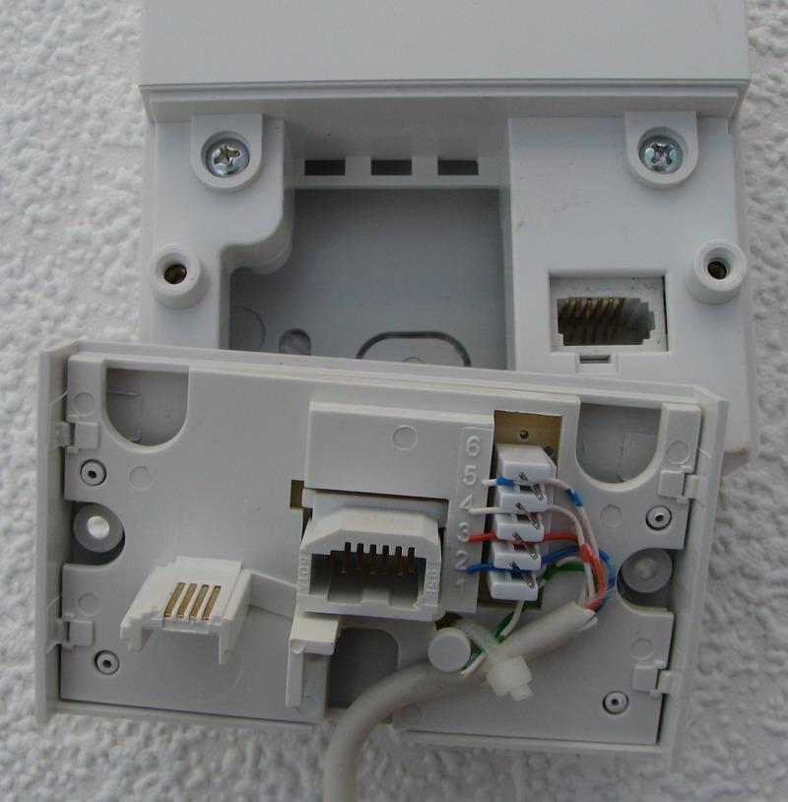
Bell Wire
"The Bell Wire picks up electrical interference that suppresses line speed and reduces stability of Broadband service. This problem impacts all homes with extension wiring to some degree"
Remove the faceplate and remove the ring wire (typically pin 3), carefully to allow for later replace!
Retrain can take 3-5 days for ADSL max/rate adaptive products

Slide 23
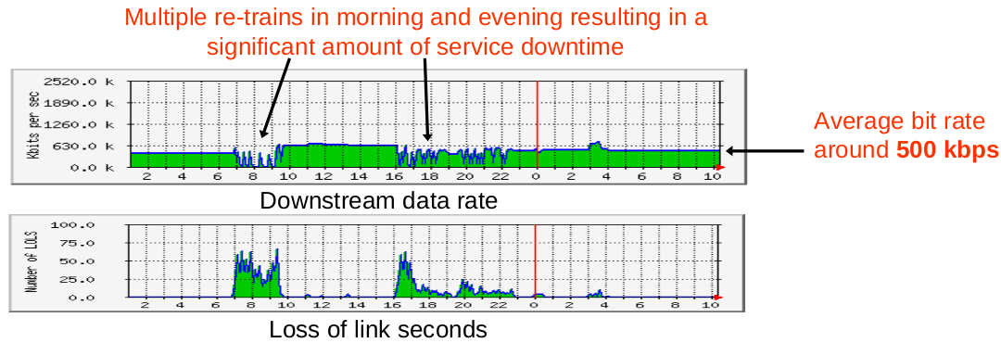
No Bell Filter

Slide 24
Bell Filter

Slide 25
Home Wiring

Slide 26
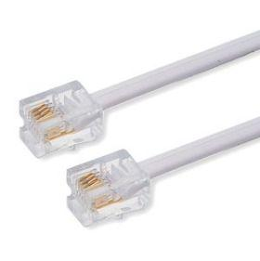
Home Wiring Improvements
Shorten the ADSL cable (1 or 2 pair RJ11 cable)
Try different filter or faceplate filter
Avoid running Ethernet next to power
Avoid installing poor quality cable and poorly terminating it

Slide 27
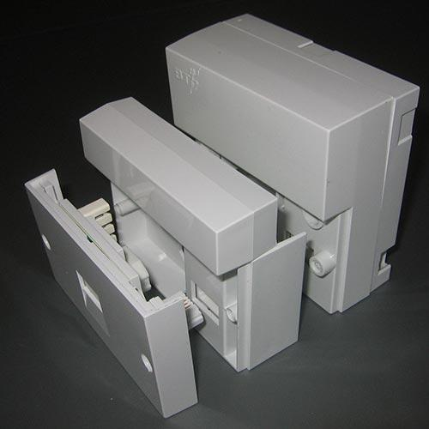
iPlate
£10 (Max) for iPlate to circumvent the Bell/Ring wire

Slide 28
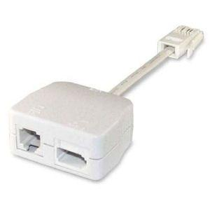
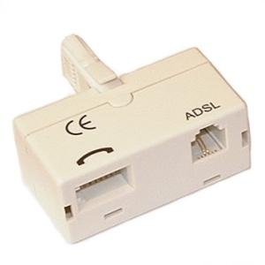
Microfilter
Standard filter
Low quality filter
NTE5 filter

Slide 29
Wireless Improvements

Slide 30
Wireless Improvements
Wireless standards: IEEE 802.11 A/B/G/N
Wireless frequencies: 5GHz, 2.4GHz, 2.4GHz, 2.4GHz & 5 GHz
Wireless interference: Alien devices, rogue access points
Wireless channels (in Europe): 14 channels (11 usable) from 2.401GHz-2.495GHz, Upto 300 channels (~20 usable) from 5.15GHz-5.725GHz.
Wireless vendors & hardware: Reputable vendors, regular firmware & driver updates

Slide 31
Wireless Standards
802.11n, every time
802.11a: 5GHz @ 54Mbps, short distance/low barrier penetration
802.11.b: 2.4GHz @ 11Mbps, longer distance/higher barrier penetration
802.11g: 2.4GHz @ 54Mbps, longer distance/higher barrier penetration
802.11n: 2.4GHz & 5GHz @ from 54Mbps, to 300Mbps, now upto 600Mbps (not domestic yet), multi-antenna multi-frequency combo gives longer distance/higher barrier penetration

Slide 32
Wireless Frequencies
2.4GHz is cheap and commonly used, but it's better for wall penetrations, yet slower (802.11b offers up to 54Mbps, average is much lower). Many household items operate on the same/similar 2.4GHz frequency ranges:
Other access points/routers!
Amature radio equipment
Bluetooth
Car alarms
Garage door openers, drive-way gate controls
Microwaves
Non-SSID-broadcasting networks
Walkie talkies & Baby monitors

Slide 33
Wireless Interference
Position within your premises in a central location: Think about walls and their composite materials (sheet metal), and their obstructions, radiators, filing cabinets, metal shelves. Raise it off the floor.
5GHz is a smaller wavelength and has more difficulties penetrating walls, switch from 802.11n 5Ghz to 802.11n 2.4Ghz, or run mixed
Point the antenna(s) up vertically: Vertical plane has greater coverage that horizontal

Slide 34
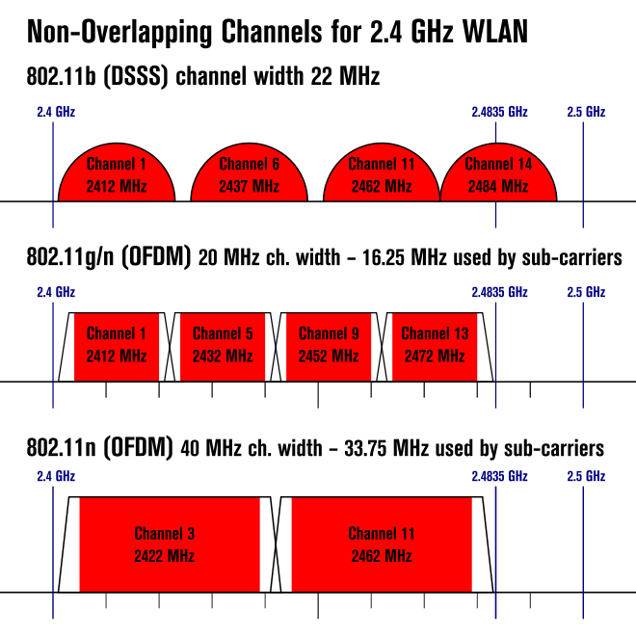
Wireless Channels
Change wireless channel: Check for overlapping channels, or simply jumpy around. NOTE: These are not always fixed!
Robbed from: http://en.wikipedia.org/wiki/List_of_WLAN_channels

Slide 35
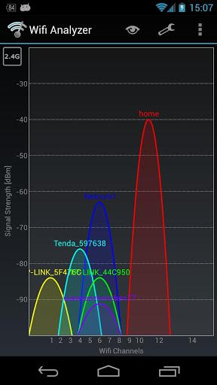
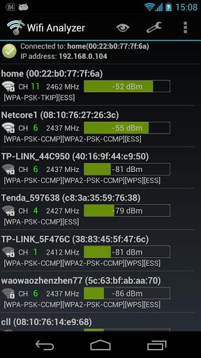
Wifi Analyzer App
Free Android App:
"Wifi Analyzer" by farproc
"Shows the Wi-Fi channels around you. Helps you to find a less crowded channel for your wireless router."

Slide 36
Wireless Vendors & Hardware
Reputable Vendors: Ubiquiti UniFi - http://linitx.com/product/13542Technicolor TG582n - http://www.technicolor.com/en/hi/digital-home/mediaaccess/dsl/wireless/adsl/technicolor-tg582n Routerboard products
High gain and directional antennas: http://www.draytek.co.uk/products/aerials.html
Update firmware of router/access point
Software update: Update kernel, compile proprietary drivers, update wifi adapter firmware

Slide 37
Wireless Summary
Switch to 802.11n/2.4GHz & 5GHz
Adjust router positioning
Check for interfering devices
Change channels
Use wireless extender
Good hardware vendor
Software updates
Correct measurements (signal strength, throughput, delay)

Slide 38
Questions?
James Bensley jwbensley@gmail.com
hampshire@mailman.lug.org.uk

