Slide 1
How NOT to Monitor The Global DFZ

Slide 2
Overview
Christmas, I’ve got two weeks off work, loads of wine and food
I’m feeling “cody”

Slide 3
Overview
The global BGP DFZ contains a non-trivial amount of “unacceptable” data (in my opinion)
Some stuff is binary “this is bad”:
RPKI invalids
full table leaks

Slide 4
Overview
Some stuff is not so clear.
What’s an acceptable…
AS path length?
prefix length?
number of communities?
Number of updates per peer/origin/prefix, per second?

Slide 5
Overview
Naming and shaming repeat offenders is proven to be less effective when compared to training those offenders
…but significantly more entertaining
We have a shortage of mavericks which nobody asked for
Did I mention the wine?

Slide 6
Overview
Epiphany: what the world needs is a ‘Top Trumps’ of worst DFZ operators

Slide 7
Overview
Why wouldn’t this be great!?!?

Slide 8
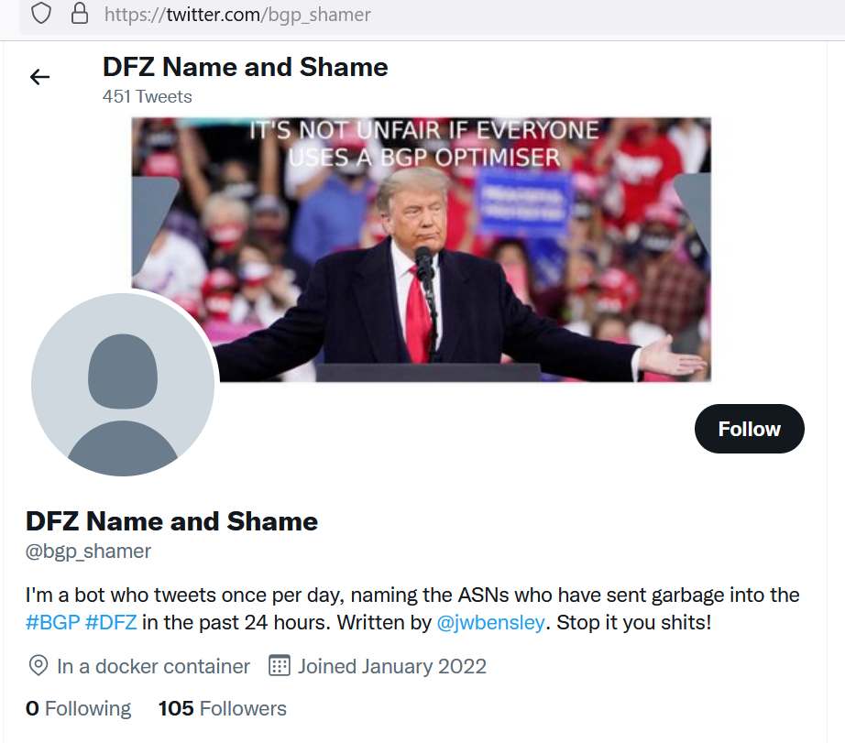

Slide 9
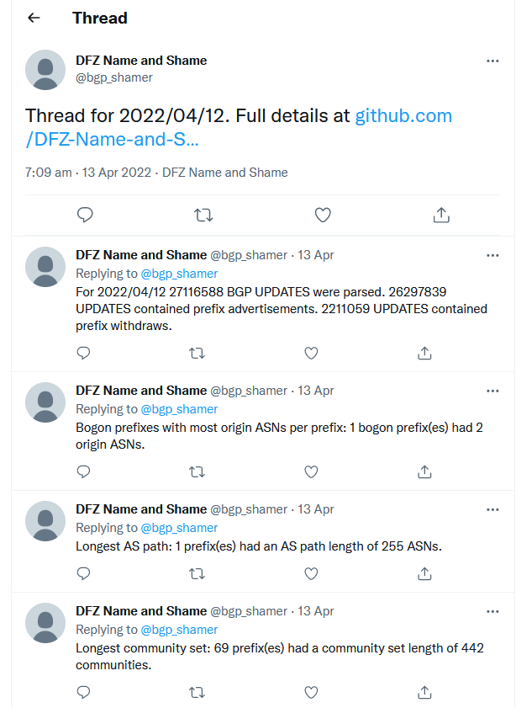

Slide 10
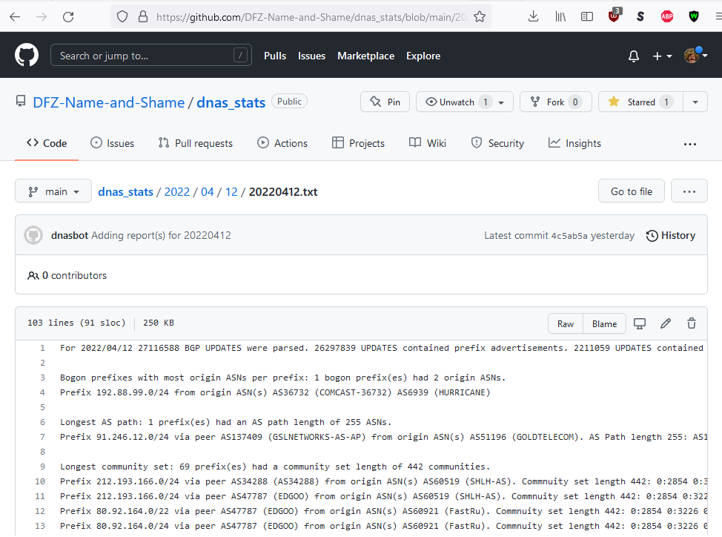

Slide 11
Overview
It’s a WIP, but I’ve already learned a lot…
You need a DFZ data source
You need code to process the DFZ data
You need compute/storage to run code and store bytes

Slide 12
Data

Slide 13
Data
Setup a BGP peering and parse the BGP UPDATES
I’m too lazy to write a new parser
Existing libraries are poop
Realtime data is not resilient (self hosting / shoestring)
Setup a BGP peering and use a JSON exporter
Realtime data
RIS Live “fire-hose” API: https://ris-live.ripe.net/
Realtime data
*** Use MRT dumps ***
Parser libraries exist, asynchronous data consumption

Slide 14
Data
RFC6396 “MRTs” - Multi-Threaded Routing Toolkit (MRT) Routing Information Export Format
Encode routing data in a binary file using a TLV structure
Note: turns out, not parser friendly
Mainly used for BGP, also supports OSPFv2, OSPFv3, ISIS

Slide 15
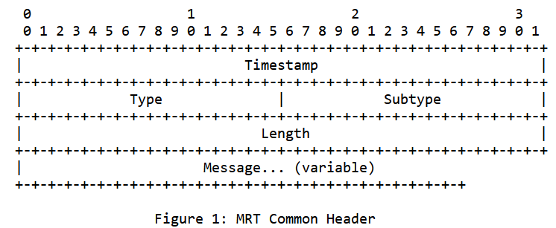
Data

Slide 16
Data
Type: TABLE_DUMP_V2
Subtypes:
PEER_INDEX_TABLE
RIB_IPV[4|6]_[UNICAST|MULTICAST]
RIB_GENERIC

Slide 17
Data
Type: BGP4MP_ET
Subtypes:
BGP4MP_STATE_CHANGE
*** BGP4MP_MESSAGE ***
*** BGP4MP_MESSAGE_AS4 ***
BGP4MP_STATE_CHANGE_AS4
BGP4MP_MESSAGE_LOCAL
BGP4MP_MESSAGE_AS4_LOCAL

Slide 18
Data
Public MRT archives in descending order of shitness:
PCH Raw Routing Data - total shite
RouteViews MRT Archive - middle shite
RIPE RIS Raw Data - a “little bit” shit

Slide 19
Data
Note: these MRT archives are all from IXPs

Slide 20
Data
Turns out - MRT files contain a lot of poop
All message types (BGP OPEN, BGP KEEPALIVE etc.)
BGP state changes
Empty BGP UPDATES
Some UPDATEs have no list of withdrawn routes
Some UPDATEs have an empty list of withdrawn routes
BGP is IPv4 biased -> v6 NLRIs are MP_REACH_NLRIs

Slide 21
Data
In summary:
Public MRT archives are “OK” but they are all IXPs, no Tier 1 / Tier 2 transits
MRTs contain their own poop
Poor availability of MRT parsing libraries (https://bgpkit.com/ is coming to the rescue!)

Slide 22
Code

Slide 23
Code
Short term: I thought, I “only” need to parse a few MRT files, generate some basic stats, and then Tweet about them
Long term:
Tag offending networks in Tweets
Send email to peeringDB contacts “yoo is teh b0g0n”

Slide 24
Code
Why not write this in Python?
mrtparse module
tweepy module
Github module
PeeringDB module
I already mentioned I’m lazy

Slide 25
Code
DO NOT write high performance code in Python

Slide 26
Code
Decompressing and parsing a “large” MRT file (~150MB RIB dump) into a Python object uses a lot of memory (circa 1GB)
Single threaded parsing is too slow
Python multithreading is shite
Python GIL means multi-processing requires full memory copy
8 cores/proc’s == 8GB of memory to parse 150MB file!

Slide 27
Code
Split MRT files into $number_of_cpu files
Splitting is single threaded
Parse each chunk on a separate CPU core
Merging of parsed results is single threaded
MRT files have no total length, no index, they are pure TLVs

Slide 28
Code
Using PyPy3 to resolve the splitting/merging performance

Slide 29
Code
Python is shit in other ways too
Dynamically typed (using mypy)
Same code has difference results in venv or pypy
Requires extensive unit testing

Slide 30
Compute

Slide 31
Compute
Where will you store the raw data?
Where will your code run?
Where will you store the results?

Slide 32
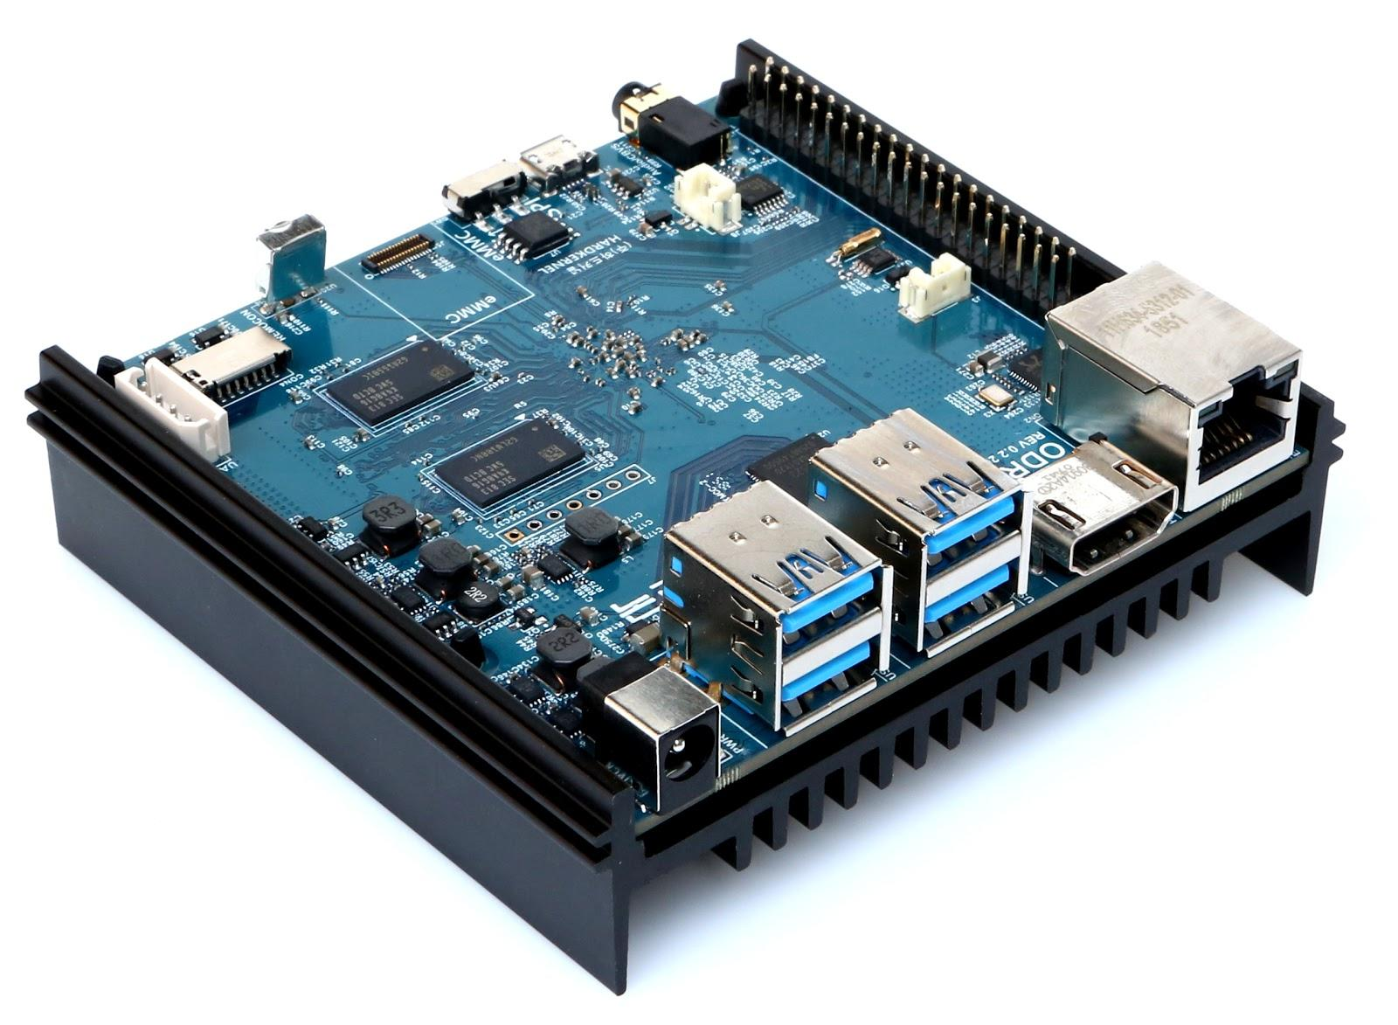
Compute & Storage
DON’T use an SBC you had lying around
n2_shat.jpg

Slide 33
Compute & Storage
ODROID-N2
Circa 80 EUROs
Quad-core ARM Cortex-A73 @ 1.8Ghz
Dual-core ARM Cortex-A53 @ 1.9Ghz
4GM RAM (–250MBs for GPU)
16GB eMMC for OS + Redis DB
64GB USB stick for “mass storage”

Slide 34
Compute & Storage
Parsing in Python is killing the polar bears

Slide 35
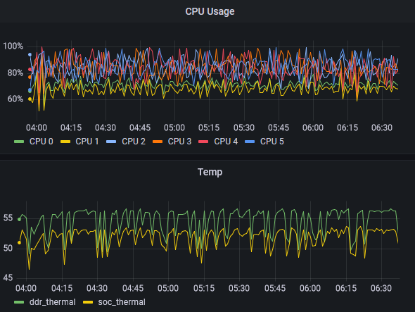
Compute & Storage
Parsing in Python is killing the polar bears

Slide 36
Compute & Storage
It’s also killing my patients

Slide 37
Compute & Storage
Currently 912 MRT files are parsed per day
~27M BGP UPDATES
About 8 hours to download and parse the stats for a day because I made a pipeline using docker-compose, which is currently broken :(

Slide 38
Lessons Learned

Slide 39
Lessons Learned
Python shit -> use Go or Rust
MRTs shit -> Use RIS-Live or equivalent peerings
SBCs are not “compute” -> Memory and storage bandwidth

Slide 40
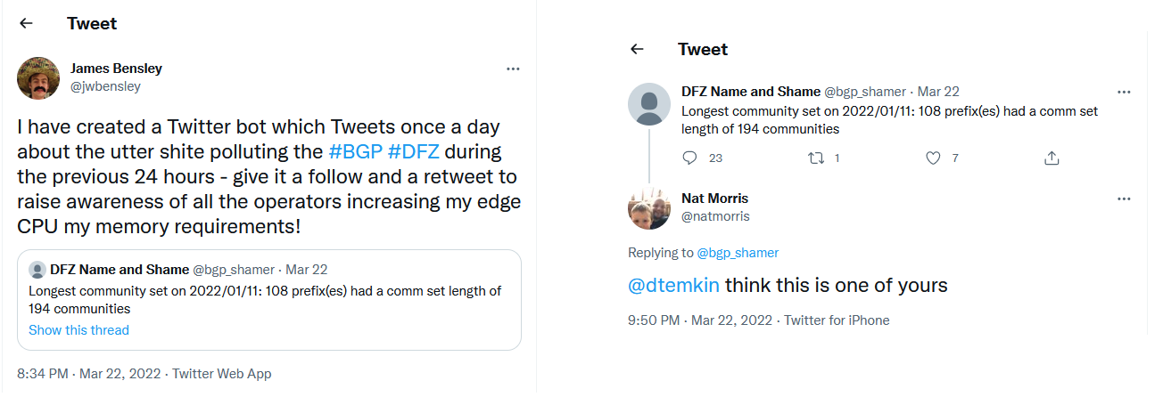
Lessons Learned
Haters gunna hate

Slide 41
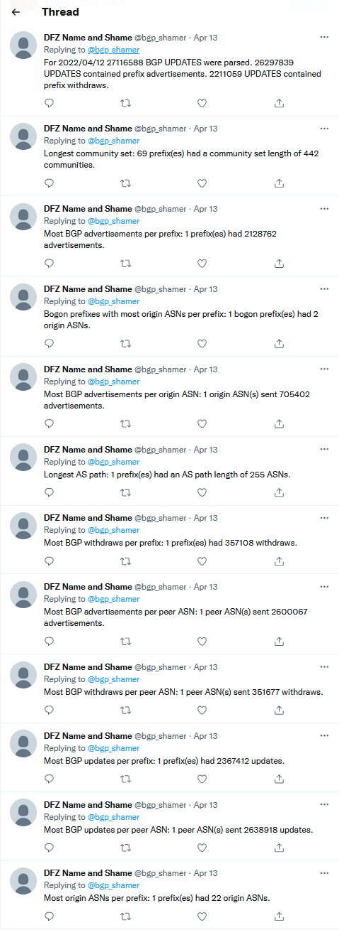
Lessons Learned
A Twitter thread is not the place to distribute a lot of information

Slide 42
End
Bot: https://twitter.com/bgp_shamer
Daily reports: https://github.com/DFZ-Name-and-Shame/dnas_stats

